Slide 1
票券小程序开发介绍
王森
2019年5月

Slide 2
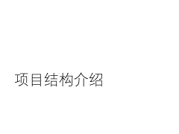
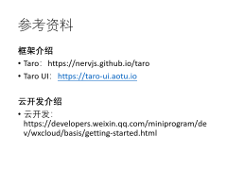
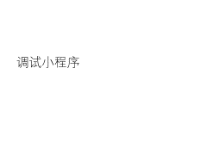
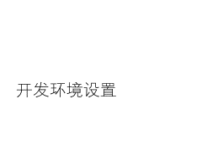
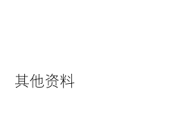
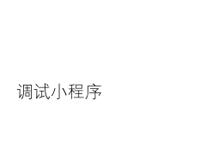
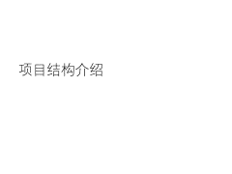
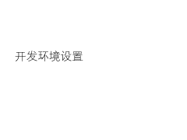

Slide 3
开发环境设置

Slide 4
开发环境安装
Git：https://git-scm.com/download/win
从远程仓库拉取代码和提交代码
Node.JS：https://nodejs.org/en/download/current
小程序 Taro 框架的编译环境
Yarn：https://yarnpkg.com/zh-Hans/docs/install
包管理工具，替代 Node.JS 默认包管理工具 npm
微信开发者工具：https://developers.weixin.qq.com/miniprogram/dev/devtools/stable.html
发布小程序、提交云函数等
Notes:
yarn 安装速度快，并行下载，并且具有本地缓存机制和锁文件。

Slide 5
环境设置
更改 npm 镜像源：
npm config set registry https://registry.npm.taobao.org
npm config set disturl https://npm.taobao.org/dist

Slide 6
Fork 代码
公共代码仓：https://github.com/sgeinterestpro/tickets_wx_lp
从公共代码仓 Fork 一份代码到自己的代码仓
https://github.com/<yours>/tickets_wx_lp

Slide 7
配置代码环境
在“命令提示符”工具内打开本地的“工作空间”，然后从仓库拉取代码：
进入 tickets_wx_lp\client 目录，执行 yarn 指令安装依赖：
等待依赖安装成功
git clone https://github.com/<yours>/tickets_wx_lp
cd tickets_wx_lp\client
yarn
Notes:
代码与环境配置完毕

Slide 8
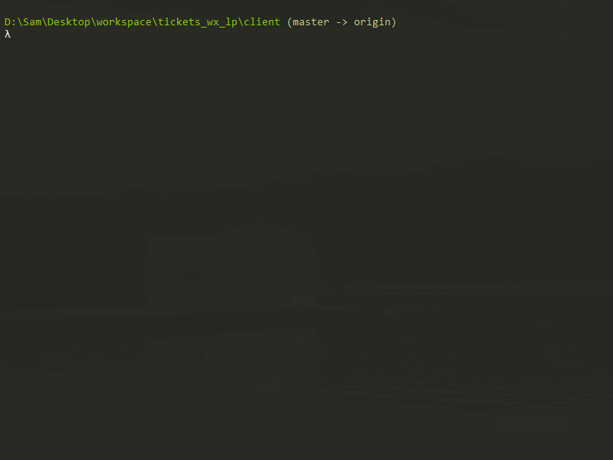

Slide 9
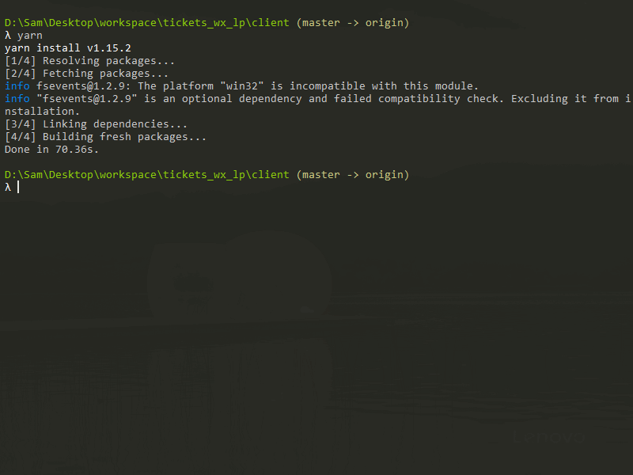

Slide 10
调试小程序

Slide 11
编译小程序
编译预览模式：
预览模式会监听 src 目录，发现代码改变时会自动增量编译。(开发时执行此命令)
编译打包模式：
打包模式会压缩代码体积，发布小程序时使用此方式。（后面上传小程序到微信服务器时使用）
yarn dev:weapp
yarn build:weapp

Slide 13
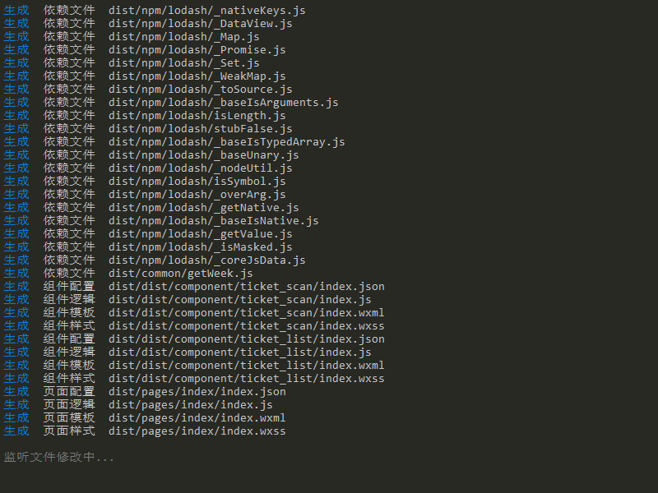

Slide 14
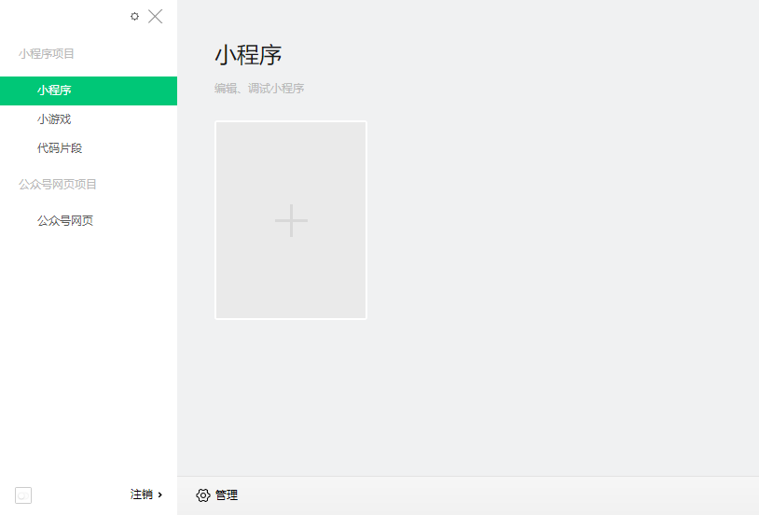

调试小程序
打开“微信web开发者工具”并使用微信扫码登陆。

Slide 15
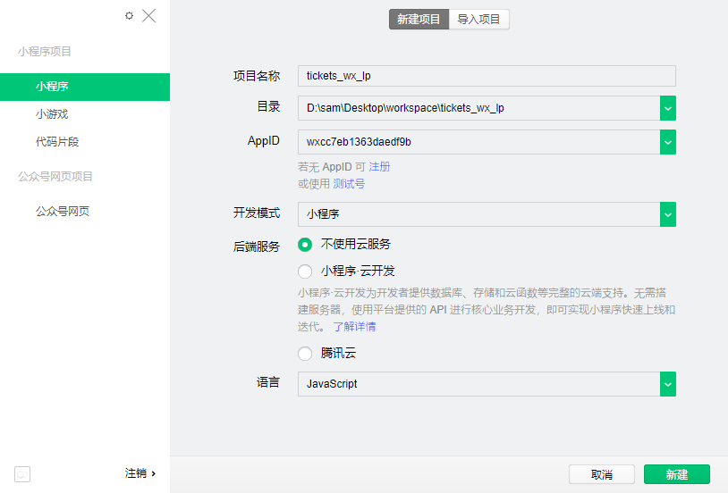
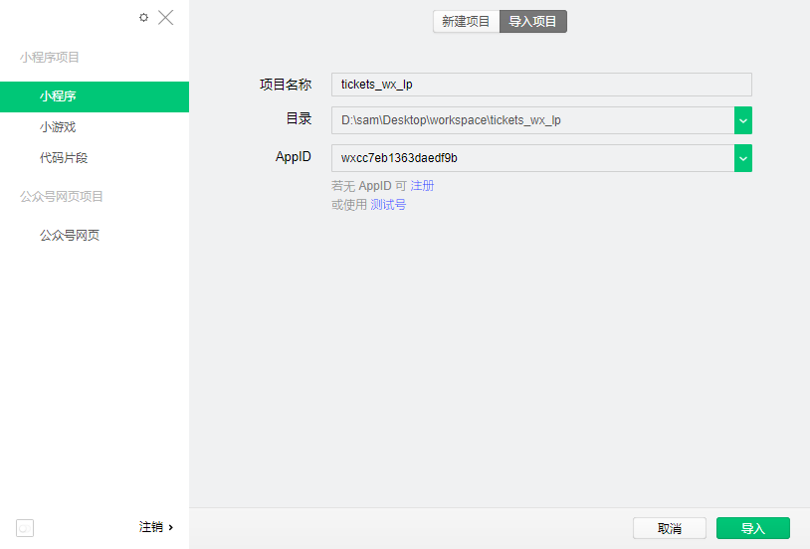
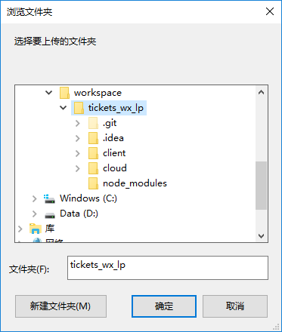
调试小程序
导入下载好的项目

Slide 16
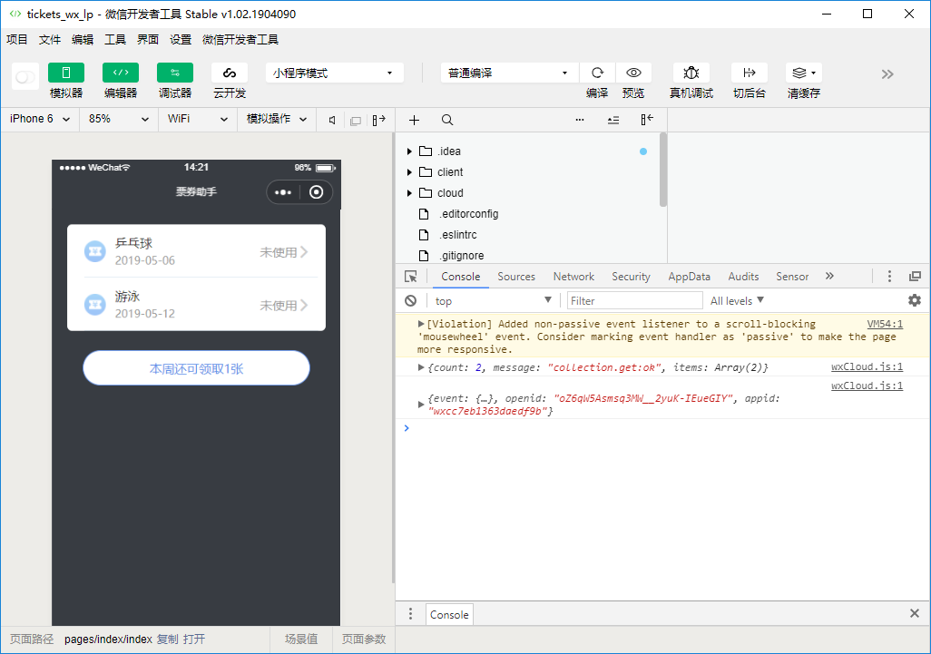
调试小程序
微信小程序调试界面

Slide 17
项目结构介绍

Slide 18
目录结构
client 小程序主目录
config 编译配置文件
src 源码
apis 接口
common 公共
component 组件
img 图像
pages 页面
cloud 云函数主目录
functions 函数列表

Slide 19
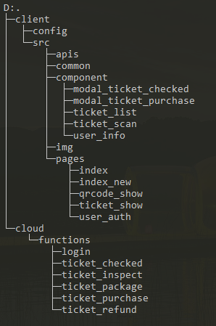
···································································小程序部分
···························································项目编译配置文件
··································································小程序源代码
·······················································小程序对服务端的接口
···················································公共模块
············································小程序组件
···········检票弹出窗口
········领票弹出窗口
································票券列表
································扫描票券
····································用户信息
·························································图片资源
·····················································小程序页面
··········································主页面框架
·································另一个样式的主页
······························二维码放大显示页面
······························票券详情页面
·································用户信息
····································································云函数部分
···················································云函数同步目录
···················································用户登录
······························检票
······························验票
······························票券列表
··························领票
·······························退票

Slide 20
主页框架
票券列表
使用票券
票券详情
二维码详情
个人信息
领取
(弹框)
删除
查看
(跳转)
扫码验票
查看二维码
(跳转)
检票

Slide 21
主页框架
用户授权引导
管理员
组员
票券列表
领取票券
个人中心
票券管理
组员管理
设置中心
扫描票券
设置中心
本周票券
归档票券
增发票券
切换角色 (管理员)
切换角色
使用
删除
增加
删除
记录导出
记录导出
一兆韦德
个人信息
个人信息

Slide 22
腾讯云
云函数
数据库
小程序

Slide 24
其他资料

Slide 25
参考资料
框架介绍
Taro：https://nervjs.github.io/taro
Taro UI：https://taro-ui.aotu.io
云开发介绍
云开发：https://developers.weixin.qq.com/miniprogram/dev/wxcloud/basis/getting-started.html

